Slide 1
Introduction to the Restoration Assistance and Awards Management System (RAAMS)
March 2016

Slide 2
Agenda
Brief Review of Federal Requirements and Resources
Overview of RAAMS and Terminology
System Access
Application Process
Post-Award Processes

Slide 3
Objectives
Hands-on Introduction to RAAMS
What you need to know to enter applications in RAAMS
Federal requirements
Supporting materials that are needed when submitting an application for funding to the Council
RAAMS data entry processes
Note: Additional training will be scheduled and is available upon request

Slide 4
Federal Requirements & Resources
OMB Uniform Guidance (2 CFR Part 200)
Federal Registration Requirements
Recipient Proposal and Award Guide
Grants
Interagency Agreements (IAAs)
Council Website

Slide 5
Uniform Guidance
2 CFR Part 200
Goals
Increase focus on performance outcomes
Streamline rules governing allocation of Federal funds
Key Elements
Focus on performance as well as compliance
Encourages efficient use of information technology and shared services
Requires consistent and transparent treatment of costs
Limits allowable costs to make best use of Federal resources
Eliminates duplicative and conflicting guidance
Located at 2 CRF Part 200, and available at www.ecfr.gov

Slide 6
Cost Principles
Published by OMB in 2 CFR Part 200
Establish a uniform approach to determining costs and promote effective program delivery, efficiency, and better relationships between grant recipients, sub-recipients, and the Federal government.
Help determine allowable costs and enforce compliance with Federal grant requirements.
Located at 2 CFR 200 subpart E, and effective as of 12/26/14 (www.ecfr.gov)

Slide 7
Procurement – 2 CFR Part 200
Subpart D - Post Federal Award Requirements Standards for Financial and Program Management Procurement Standards
§200.317 Procurements by states
§200.318 General procurement standards
§200.319 Competition
§200.320 Methods of procurement to be followed
§200.321 Contracting with small and minority businesses, women's business enterprises, and labor surplus area firms
§200.322 Procurement of recovered materials
§200.323 Contract cost and price
§200.324 Federal awarding agency or pass- through entity review
§200.325 Bonding requirements
§200.326 Contract provisions

Slide 8
Federal Registration Requirements
DUNS Number
Every Council applicant must obtain a unique identifier or DUNS number
These numbers are free, and can be obtained by contacting Dun and Bradstreet at 1-866-705-5711 or visiting www.dandb.com
SAM
Every grant applicant must register in the System for Award Management (SAM) database, which automatically registers applicants for
Central Contractor Registration (CCR)
Eligible Parties List System (EPLS)
SAM is free and can be found at www.SAM.gov
See Recipient Guidance Manual Part III Chapter II.A.2

Slide 9
2 CFR Part 200 – Pre-Award
Subpart C
Pre-Award Requirements
(200.200) – Purpose
(200.201) – Use of Grants Agreement (including fixed amount awards), cooperative agreements, and contracts
(200.202) – Required to provide public notice of Federal Financial assistance programs
(200.203) – Notice of funding opportunities
Followed by Official Review
(200.204) – Federal awarding agency review of merit of
proposals
(200.205) – Federal awarding agency review of risk posed
by applicants

Slide 10
Organizational Self-Assessment
Council will conduct risk assessments of “first time” non-Federal recipients (2 CFR 200.205 Federal awarding agency review of risk posed by applicants)
First round of Council awards, all States considered “first time” recipients
Forms and instructions available on Council Grants Office website (www.restorethegulf.gov/gcerc-grants-office)
Document List Addendum required

Slide 11
Risk Assessments by Federal Recipients
Under 2 CFR 200.205, prior to making a Federal award, agencies must:
Review information available through SAM, FAPIIS, “Do Not Pay”
Have a framework for evaluating the risks posed by applicants before they receive federal awards

Slide 12
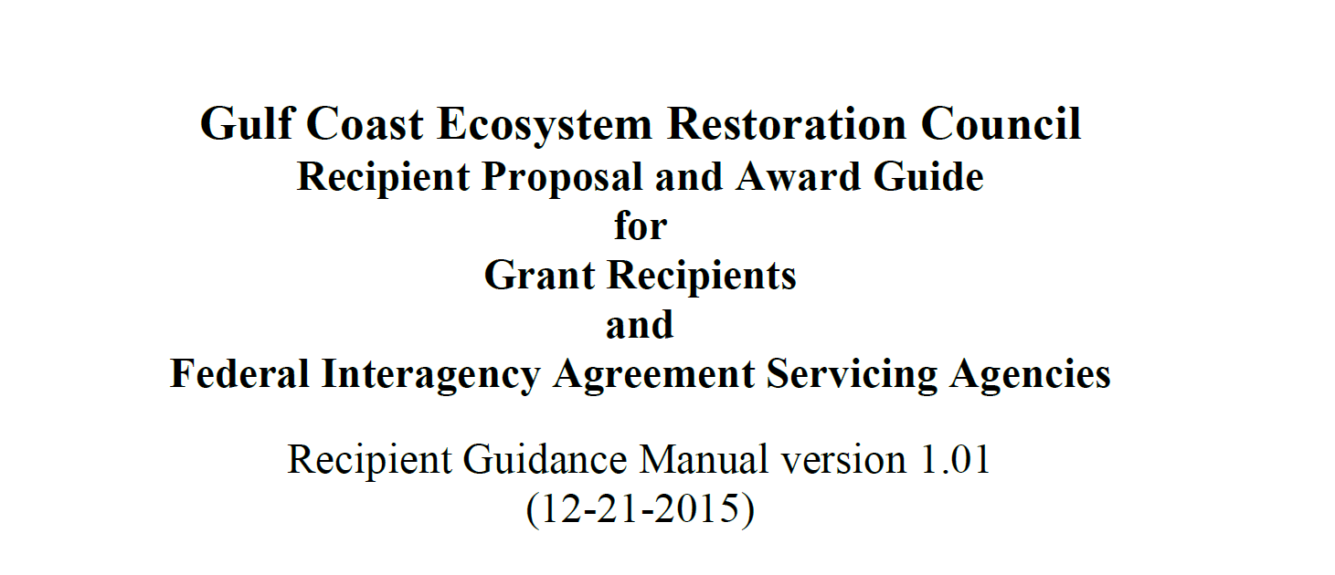
Recipient Guidance Manual
Available here -
www.restorethegulf.gov/gcerc-grants-office

Slide 13
Recipient Guidance Manual
Background
2 CFR Part 200
RESTORE Act
Treasury Rules
Applies to
Grants
Interagency Agreements (IAAs)
Covers entire life cycle of award/agreement
Both Council Programs - Buckets 2 (FPL) & 3 (SEP)
Does not provide detailed RAAMS instructions

Slide 14
Recipient Guidance Manual
Part I - Proposal Guide: Council-Selected Restoration Component (Bucket 2)
Part II - Proposal Guide: Spill Impact Component (Bucket 3)
Part III - Application Guide (applies to both components)
Part IV - Award and Administration Guide (applies to both components)

Slide 15
Resources – Grants Office Web Page
Main Page
www.restorethegulf.gov/gcerc-grants-office
Recipient Guidance Manual
RAAMS links
Resources Page
Links
Templates
Training page
Recipient Guidance Manual training webinar (12-11.15)

Slide 16
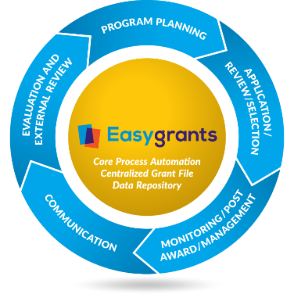
RAAMS
Restoration Assistance and Awards Management System
Easygrants platform
Grants and IAA
Management
Pre-award
Award
Post-award

Slide 17
RAAMS Terminology
Programs
Funding Cycle
Workflow
Tasks
Bucket 2 - FPL | Bucket 3 - SEP
Proposals | SEP Review
Applications | Applications
Reporting | Reporting
Revisions / Amendments | Revisions / Amendments
Close-outs | Close-outs

Slide 18
Basic Layout
Funding Cycles - Define the Workflow - Connect the resulting Grants and IAAs to a Program
Program 1
Sub Program 1
Cycle 2015A
Cycle 2015B
Sub Program 2
Cycle 2015C
Programs
Funding Opportunities
Funding Cycles
Cycle 2016
Grant
(EGID 1)
Grant (EGID 2)
Grant
(EGID 4)
Grant (EGID 3)
Grant (EGID 5)
Grants
Grant
(EGID 7)
Grant
(EGID 8)

Slide 19
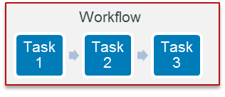
Tasks, Workflow & the Grant File
Task 1
Task 2
Task 3
Workflow:
a sequence of tasks.
Funding Cycle Workflow: defines a specific sequence of tasks for each grant created under that funding cycle.
Grant (or IAA) File: a container created under a Funding Cycle each time the workflow is initiated. Contains tasks (Activity tab) and data collected through tasks.

Slide 20
What is a Task?
Step in the workflow for a user to complete
Primary method of data entry for grants
Assigned to a single person by role or workgroup (displayed in the user’s task list)
Outcome of the task drives the next task in the workflow

Slide 21
Typical Workflow*
Authorized Signature
Signing Official
Input & Submit Proposal
Review Proposal & Develop FPL
Input & Submit Application
Review Application & Finalize Grant or IAA
Input & Submit Reports
Review Reports
Applicant
Council/Council Staff
* Not including revisions, amendments or close-out

Slide 22
Task Assignment
Options
Assigned by Workflow
Assigned by Administrator
Requested by User
Assigned to
Individual User
Workgroup (staff only)
User “claims” task

Slide 23
User Home Page
Each user’s home page (after login) shows their incomplete tasks and due dates

Slide 24
RAAMS Access – Primary Contact
For each project or program, at least one primary contact must:
Be identified in writing as authorized by the sponsoring Council member or designee to submit a grant or agreement application, and
Complete RAAMS training
Primary Contact (usually) ≠ Agency Responsible Official, Council member or designee
Notes:
Agency Responsible Official (ARO)
Empowered to make certifications and assurances
Can commit the organization
= Authorized Organizational Representative

Slide 25
RAAMS Access – Primary Contact
The Primary Contact for each approved project or program will:
Start the application process
Submit the application
Be assigned post-award tasks (reporting, etc.)
Primary Contacts can associate other users to assist with the application process
Note: at this time, only the primary contact can enter budget information
Notes:
More to come on these topics once we get into RAAMS.

Slide 26
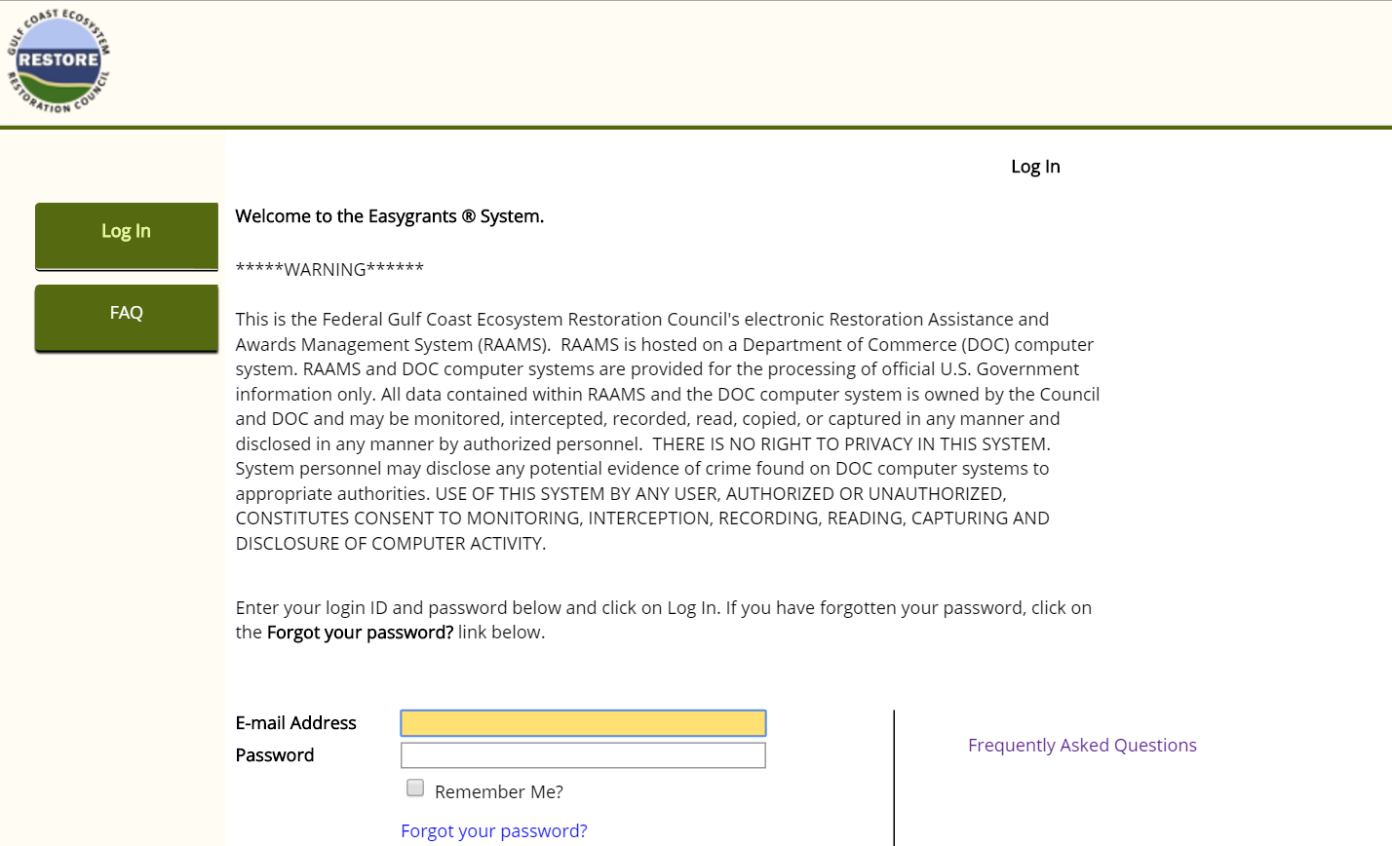
Accessing RAAMS
Options:
Self-Registration
(Administrator
must associate
with organization)
Administrator Creates User
New User? Register Here
Frequently Asked Questions

Slide 27
System Security
Federal system
Single-user accounts – do not share!
Password requirements – do not share!
Timeout
Automatically logged out after 30 minutes of “inactivity”
Inactivity = no interaction with the server (i.e., saving data or refreshing screen)
10 minute warning provided

Slide 28
Hint…
Save your work often
Ways to save:
“Save” button saves your work and keeps you on the same page
“Save and continue” saves your work and moves you to the next page
Either option will “save” you from timing out

Slide 29
Create a login
Go to:
raams-test.restorethegulf.gov
Click on “Register Here” and complete the requested information
Password must meet requirements
(note: we are working in a test environment for training purposes; “real” applications will be entered in the identical production environment once access to RAAMS has been granted)

Slide 30
Password Requirements
At least 12 characters and no more than 20
Different from your last 8 passwords
Include a combination of uppercase and lowercase letters, numbers, and special characters
Do not include your first or last name, birthdays, or other personal information
Do not include dictionary words, common names, or simple patterns

Slide 31
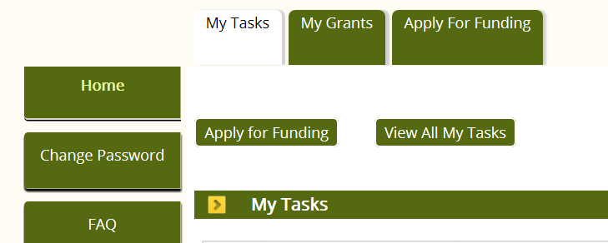
Log in to RAAMS
User Home Page
Notes:
My Tasks: The My Tasks tab shows all tasks currently assigned to a given user. In RAAMS, tasks comprise any number of web pages which enable users to compete standard activities such as proposal submissions, applications for funding, amendment requests, and performance and financial reports. To open a task, simply click on the task name. Users are strongly encouraged to check their My Tasks page frequently in order to keep current with assigned tasks and their deadlines. Once a task has been submitted, it will no longer automatically appear under My Tasks, but can be viewed by clicking the View All My Tasks button.
My Grants: The My Grants tab displays a list of all applications and awards to which the user has access. Clicking on the EGID number will open the Award File for the relevant submission or award. The Award File contains current information on the application or award, as well as a list of tasks completed by or assigned to the applicant. Information submitted by the applicants and recipients via tasks is saved to this location. The applicant controls access to each Award File via the Public Project File Access control (see the Personnel section for more information).
Apply for Funding: Users can apply for available Council-Selected Restoration Component or Spill Impact Component funding opportunities by clicking on Apply for Funding. Users will be prompted to select from available and open opportunities before proceeding into an application.
Users who have previously submitted a grant application and initiate a new application under the same Funding Opportunity will be asked to confirm their selection. Users who need to access an application in progress should not submit a new application, but rather access the existing application, which should appear on the My Tasks page.

Slide 32
Applications under the Initial FPL
Original proposals not entered in RAAMS
Only Category 1 projects and programs on FPL can be entered
Do not combine multiple FPL projects into a single application
In general, 1 approved project = 1 application
Exceptions:
Co-sponsored projects or programs where each partner is carrying out a discrete scope of work
Projects or programs having discrete components with different success criteria/metrics

Slide 33
Help Resources
Council Staff
RAAMS Users’ Guide
In RAAMS
Instructions
Top of each RAAMS page
Help Files
Linked on each RAAMS page
Frequently Asked Questions
Technical and Program Support Request Links

Slide 34
Council Staff and Roles
Grants and Compliance Division
Grants Officer
Grants Specialists
Administrative Division
Fiscal Specialists
IT Specialist/System Administrator

Slide 35
Council Staff and Roles
Program Office
Science Officer
Director of Environmental Compliance
Program/Natural Habitat Specialists
External Affairs Specialist
External Reviewers
Best Available Science
Data Plans
Other Technical Specialists

Slide 36
Council Staff and Roles
Executive Director
Deputy Executive Director/Program Officer
CFO/Director of Administration
General Counsel

Slide 37
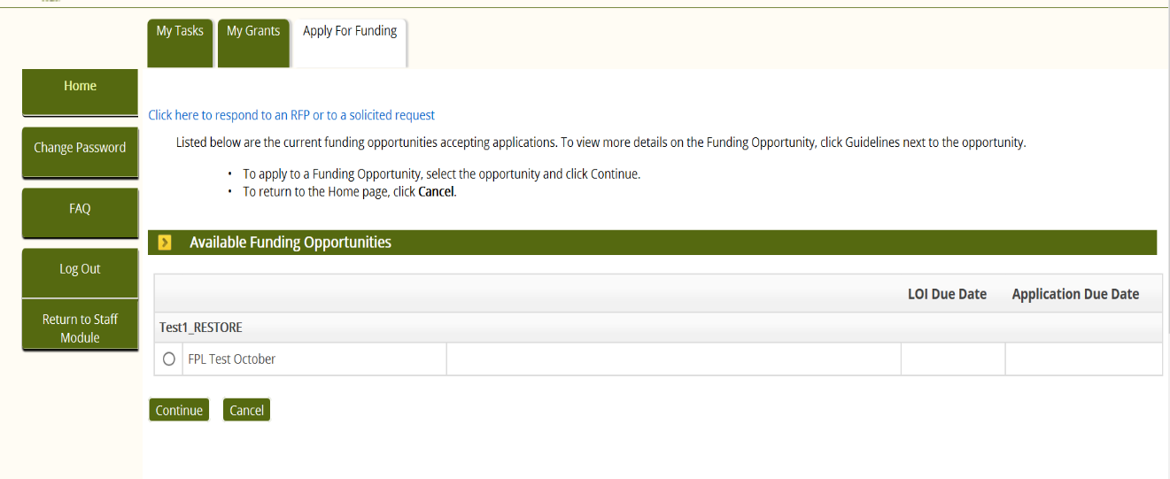
Starting the Application
Two ways to apply for funding:
Invitation – requires a code
(FPL projects)
User-driven
(proposals)
Notes:
Use invitation method.

Slide 38
Avoid Duplicate Applications
If have previously submitted a grant application and attempt to initiate a new application under the same Funding Opportunity, you will be asked to confirm that this is correct
If need to access an application in progress, do not submit a new application
Single person in organization (Primary Contact) should be designated to initiate each application
Access the existing application, which should appear under My Tasks
If “missing” contact the primary contact for the application, then contact the Grants Office

Slide 39
Personnel Page

Slide 40
Personnel Page
Managing Users
Once an initial task has been started, the Primary Contact can associate other users who have registered in RAAMS with the project under the “Personnel” tab
For each project or program, each associated person is assigned the following designations:
Primary contact (or not)
Role
Level of access
“Public project file access” (or not)

Slide 41
Personnel Page – Uploads
Authorization Letter
Primary Contact
Secondary Contact (if applicable)
Other agency personnel working on the project or program
Data Manager

Slide 42
Personnel Page
Project personnel
Members or affiliates of the prime recipient organization who
will require edit or view access to the application and/or the Award File, or
represent key project personnel
Responsible Agency (Signing) Official
Project Lead/Primary Investigator/Technical POC
Financial Point of Contact

Slide 43
Personnel Page
Other contacts (individuals)
Contractors
Subrecipients
Personnel from partnering organizations
Individuals who
represent key project personnel, and/or
will require edit or view access to the FPL Application Task and any subsequent tasks once an award is made
No access to Award file (no “public project file access”) for Other Contacts
Notes:
Only enter individuals who need access for some reason. Will discuss entering organizations such as subrecipients shortly.

Slide 44
Personnel Page
Notes:
Use the “Add” button to associate personnel. Refer to instructions in RAAMS Manual on how to associate a user.

Slide 45
Designating Primary Contact

Slide 46
Personnel Roles – Project Staff
Agency Responsible Official
Project Lead/Primary Point of Contact
Financial Point of Contact
Data Manager
Technical Staff
Fiscal Staff
Administrative Staff
Research Staff
Designated “role” is independent of “Primary Contact” designation and access permissions
Notes:
As you prepare your applications, let us know if you think we’ve missed an important role.

Slide 47
Personnel Roles – Other Contacts
Contractor
Subrecipient
Partner
Designated “role” is independent of “Primary Contact” designation and access permissions

Slide 48
Access/Permission Levels
Controls the level of access to
the current task
once an award is made, any future tasks
No Access
View Only
Data Entry
Financial
Full Access*
Secondary Contact (full access, except budget)*
* Cannot change primary person, certify application or submit application or future tasks; only Primary Contact can perform these actions
Notes:
Permission Level Permission level controls the level of access to the current task and, once an award is made, any future tasks. Possible values are:
No Access: Individuals with No Access will not be able to view this task or future tasks. If an individual has Public Project File Access but is given No Access at the task level, that user will only be able to view information entered as part of a task once that task has been submitted and the results saved within the Award File.
Primary Contact
Required for all project/program applications in RAAMS.
One Primary Contact must be designated for each project or program prior to starting the application process.
The Primary Contact must have completed RAAMS training.
The Primary Contact is the only individual who can initiate the application, electronically sign the application, and submit the application in RAAMS.
The Primary Contact is one of only two user designations able to associate project personnel, the other being the Secondary Contact.
The Primary Contact has full edit access for the entire application.
The Primary Contact inherits ownership of all subsequent project tasks (revisions, progress reports, etc.) and receives email notifications regarding the project/program (e.g., notification of upcoming due dates).
Secondary Contact
Optional Designation.
The Secondary Contact is one of only two user designations able to associate project personnel, the other being the Primary Contact.
The Secondary Contact must be assigned by the Primary Contact.
The Secondary Contact has full edit access for the entire application with the exception that he/she cannot edit the budget, electronically sign or submit the application.
Has view-only access to the Budget screen.
Full Access
Optional Designation.
Assigned by either the Primary Contact or Secondary Contact.
Has full edit access for the entire application with the exception that he/she cannot associate other users, edit the budget, electronically sign, or submit the application.
Has view-only access to the Budget screen.
Data Entry
Optional Designation.
Assigned by either the Primary Contact or Secondary Contact.
Has edit access to the following data screens: Application Info, Organizations, Locations, Leveraged Funding, Tribal Support, Environmental Compliance, Uploads, Comprehensive Plan Criteria, Comprehensive Plan Narratives, Emphasis Areas, and Metrics.
Has view-only access to the following data screens: Budget, Cash Forecasting, and Milestones.
Financial
Optional Designation.
Assigned by either the Primary Contact or Secondary Contact.
Has view-only access to the following data screens: Application Info, Organizations, Locations, Leveraged Funding, Tribal Support, Environmental Compliance, Uploads, Comprehensive Plan Criteria, Comprehensive Plan Narratives, Emphasis Areas, and Metrics.
Has edit access to the following data screens: Cash Forecasting and Milestones.
Access to the Budget data screens (Budget Reassignment) can be requested by the Primary Contact.
View Only
Optional Designation.
Assigned by either the Primary Contact or Secondary Contact.
Has view access to the entire application, but cannot edit or add values.

Slide 49
Public Project File Access
Allows users to access the Award file
Current award information
Results of previous tasks completed as part of that award
Future tasks scheduled
Note: Award file is searchable but “view only”

Slide 50
Organizations Page
Users are associated with an organization
Organizations are associated with a project
Council Members
State Agencies
Federal Agencies
Subrecipients
Contractors
Cooperating Organizations

Slide 51
Organizations Page

Slide 52
Organization Roles
Prime
Reserved for Primary Organization
Must match the affiliation of the Primary Person
Partner
Subrecipient
Contractor
}
Enter in Project Organizations section
Note:
Do not use “Performance Sites”

Slide 53
2 CFR 200 – Contents of Application
In RAAMS
Subpart C Requirement
Mandatory Standard Form - SF-424 Application for Federal Assistance | Data Entry
Non-Construction Forms - SF-424A Budget information - Non-Construction SF-424B Assurances - Non-Construction | Data Entry Upload Attachment
Construction Forms SF-424C Budget information for Construction SF-424D Assurances for Construction Programs | Data Entry Upload Attachment
Application Certifications | Upload Attachment
Any Program-Specific Requirements | TBD
Detailed Budget Narrative | Upload Attachment
Program Narrative and Work Plan | Upload Attachment

Slide 54
Certifications – Required Uploads
Council Certifications
SF-424 Assurances appropriate to project/program
SF-424B Assurances - Non-Construction
OR
SF-424D Assurances for Construction Programs
Notes:
Council Certifications include:
RESTORE Act specific certifications
Drug-Free Workplace
Debarment and Suspension

Slide 55
Application Components
Two main components to an application:
1 – Project Information
Data entered in RAAMS
Supporting Narratives and Information
See Recipient Guidance Manual Part III, Chapter II, Section B.2
2 – Budget Information
Cost by SF-424 Budget Categories entered in RAAMS
Supporting Narratives and Information
See Recipient Guidance Manual Part III, Chapter II, Section B.3

Slide 56
Project Information
Project information must:
Correspond to activities described in the FPL
Use best available science
Details, details, details

Slide 57
Project Information – Uploads
Required Uploads
Executive Summary
Technical/Project Narrative
Project/Program-Specific Uploads, e.g.,
Reference List
Construction (e.g., feasibility studies, engineering designs, reports, etc.)
Land Acquisition (e.g., appraisals, agreement to purchase, title opinions, etc.)

Slide 58
FPL Project Application Pages
Application Information
Location Information
Comprehensive Plan Criteria
Emphasis Areas
Detailed Budget
Leveraging
Cash Forecasting
Milestones (activity-based costing)
Metrics
Tribal Support
Environmental Checklists
Uploads
Electronic Signature
Review & Validate

Slide 59
Application Information Page
In RAAMS
Project Title | Text Entry
Project Start and End Dates | Date Entry
Project Abstract | Text Entry
Requested Amount | Text Entry
Notes:
Project Title: The title of the project or program.
Project Start Date: The anticipated start date of proposed activities. This is the date the applicant wants the award term to start.
Project End Date: The anticipated end date of proposed activities. This is the date that the applicant wants the award term to end.
Project Summary: A short narrative summarizing the proposed project or program. The project summary is limited to 5,000 characters (approximately 750 words).
Requested Amount: The amount of Council funding requested. The requested amount does not include funds pledged or anticipated from other sources. Instances of leveraged funding, including co-funding required to complete the objective(s), are captured in other sections of the FPL Application Task. The requested amount should be equal to the amount shown as committed to the project or program on the Final FPL. If there are questions about this amount, or if these amounts are not equivocal, contact the Grants Officer.

Slide 60
Application Information Page

Slide 61
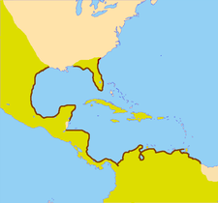
Location Information Page
Location Data
Country
State(s)
Congressional District(s)
Description
Counties if applicable
“Gulf-wide”
Other descriptive information
Project Maps will be an upload

Slide 62
Location Information Page

Slide 63
Location Information Page
Notes:
Use the Description field to enter other descriptive information about the project location and the location of project benefits (“gulf-wide”, counties, etc.)

Slide 64
Location Information – Uploads
Required Uploads
Project Map
GIS Shapefiles
For this FPL, existing shapefiles and maps will be provided to applicants for upload

Slide 65
Leveraged Funds Page (Part 1)
Identify and briefly describe where the project or program builds upon, benefits or furthers activities funded other Deepwater Horizon funding streams
NRDA
NFWF
Other “Buckets”
Other leveraging

Slide 66
Leveraged Funds Page (Part 1)

Slide 67
Leveraged Funds Page (Part 2)
Amount ($)
Type of leveraging
Co-funding
Adjoining
Building on other work
Source
Type of source (e.g., Federal, NGO, etc)
Status of leveraged funding (received, pledged, proposed)
Description / Notes
Notes:
Co-Funding: Costs will be shared across funding from two or more sources. The leveraged funding from all sources is required in order to achieve the project or program objective.
Builds on Other Work: The project builds upon activities completed as part of other projects or programs. but is not captured by either of the other two types of leveraging
Adjoining: Activities are proposed in a location that adjoins another existing or proposed project.

Slide 68
Leveraged Funds Page (Part 2)
Notes:
Use the Add button to describe leveraged funding. See RAAMS Guide for instructions.

Slide 69
Leveraged Funds Page (Part 2)

Slide 70
Leveraged Funds – Uploads
Suggested Uploads
Letters of Support
Letters of Commitment
Documentation of Leveraged Benefits

Slide 71
Tribal Support Page
Identify federally-recognized Indian Tribes supported or benefitted by project or program activities

Slide 72
Tribal Support – Uploads
Suggested Uploads
Letters of Support
Documentation of Benefits

Slide 73
Comprehensive Plan Criteria Pages
In RAAMS
Watershed | Choice list
Goals – Primary & Secondary | Choice list & text narrative
Objectives – Primary & Secondary | Choice list & text narrative
Priority Criteria | Choice list & text narrative
Commitments | Choice list & text narrative
Phases | Choice list
Project or Program | Choice list
Notes:
Project Phase(s): Applicants must indicate which project phase(s) apply to the project or program. At least one project phase must be selected. Applicants may select as many phases as are applicable. Project phases include: planning, implementation, and technical assistance.

Slide 74
Comprehensive Plan Criteria Pages

Slide 75
Comprehensive Plan Criteria Pages

Slide 76
Comprehensive Plan Narratives

Slide 77
Emphasis Areas Page
Short narrative responses
How does project or program related to the four emphasis areas in the Comprehensive Plan?
Notes:
Emphasis Area 1: How is the proposed activity foundational in the sense that the project or program forms an initial core step (or steps) in addressing a significant ecosystem issue, and that future activities can be tiered to substantially increase the benefits?
Emphasis Area 2: How will the proposed activity be sustainable over time?
Emphasis Area 3: Why is the proposed activity likely to succeed?
Emphasis Area 4: How does the proposed activity benefit the human community?

Slide 78
Emphasis Areas Page

Slide 79
Milestones Page
Milestones or activities
Deliverables
Start and End Dates
Activity-based costing for each “area of effort”
Planning
Implementation
Engineering and Design
Data Management
Etc.
Description

Slide 80
Milestones Page

Slide 81
Milestones Page

Slide 82
Milestones Example
Milestone/ Activity | Milestone Type | Start Date | Completion Date | Deliverable (Y/N) | Anticipated Cost ($)
Design structure; produce E&D plan for construction (deliverable) | Engineering and Design | 8/2/2016 | 12/30/2016 | Yes | $20,000
Construction of structure (deliverable) | Construction | 1/2/2017 | 6/30/2017 | Yes | $250,000
Water Quality Monitoring; quarterly data (deliverable) | Scientific Monitoring/ Metrics | 1/2/2017 | 12/30/2022 | Yes | $80,000
Operations and Maintenance | Long-term Operations and Maintenance | 7/1/2017 | 6/30/2022 | No | $25,000

Slide 83
Metrics Page
Measures of Success
Objective
Quantifiable
Grouped in Templates by Comprehensive Plan Objective
List of initial metrics and instructions for each available on the Grants Office Resources web page
Discuss with program staff prior to submitting application

Slide 84
Metrics Page
1
2

Slide 85
Metrics Page

Slide 86
Metrics – Required Uploads
Observational Data Plan:
Describes and guides the collection of any data collected, compiled or utilized as part of a project
Preliminary Observational Data Management Plan:
Ensures observational and compiled data are managed and delivered to Council staff
See
Data Collection and Management Presentation

Slide 87
Environmental Compliance Checklists
Environmental Requirement | Has the Requirement Been Addressed? | Compliance Notes (e.g., status of application, permit number, etc.)
Clean Water Act Section 404 | ___ Yes ___ No ___ N/A
River and Harbors Act Section 10 | ___ Yes ___ No ___ N/A
Provide on checklists
Status for each requirement (addressed?)
Notes regarding the status(e.g., date permit applied for, permit number if received, etc.)
Provide any new supporting information as an Upload

Slide 88
Environmental Compliance Pages
Checklist 1 -
Compliance with some requirements has already been documented for FPL projects
National Environmental Policy Act
Endangered Species Act
National Historic Preservation Act
Magnuson-Stevens Fishery Conservation and Management Act
Fish and Wildlife Coordination Act
Document and verify compliance
No uploads required unless new information

Slide 89
EC Checklist 1

Slide 90
Environmental Compliance Pages
Checklist 2 -
Prior to awarding a grant or IAA under the Council-Selected Restoration Component, the Council must comply with:
Coastal Zone Management Act
Coastal Barrier Resources Act
Farmland Protection Policy Act
The Council will work with the sponsors of each FPL activity to address these laws, as applicable

Slide 91
EC Checklist 2

Slide 92
Environmental Compliance Pages
Checklist 3 -
Post award, recipients must comply with all other applicable federal environmental laws
Awardees responsible for
Identifying and addressing all applicable federal environmental requirements, and
Providing the Council with documentation verifying compliance with such requirements
Also responsible for compliance with applicable State and local requirements

Slide 93
EC Checklist 3

Slide 94
Environmental Compliance - Uploads
Supplemental and Supporting Environmental Compliance Information, e.g.,
Permit cover letters
Permit application submittal documentation
Letter of Concurrence
Agency Determinations
Information on compliance with other Federal, State or local requirements
Any other compliance documentation
No need to resubmit information already on file with the Council for the project – just reference it!

Slide 95
Application Components
Two main components to an application:
1 – Project Information
Data entered in RAAMS
Supporting Narratives and Information
See Recipient Guidance Manual Part III, Chapter II, Section B.2
2 – Budget Information
SF-424 Budget Categories entered in RAAMS
Supporting Narratives and Information
See Recipient Guidance Manual Part III, Chapter II, Section B.3

Slide 96
Proposed Budget
Must be reasonable and consider the technical necessity for and price reasonableness of the proposed budget (2 CFR 200.404 - Reasonable costs)
Must be supported by a narrative describing each cost element in sufficient detail to enable the Grants Management Specialist to confirm whether costs are eligible, allowable, allocable, reasonable, and necessary for the project
Amounts (budget and narrative) must match
Notes:
Eligible
Permitted by statute, program guidance, or regulations
Must also conform to any Federal limitations
Allowable
Must be necessary and reasonable for the performance of the award and authorized by the appropriate Cost Principles (2 CFR 200.403 Factors affecting allowability of costs)
Reasonable
Does not exceed that which would be incurred by a prudent person under the circumstances prevailing at the time the decision was made to incur the cost (2 CFR 200.404 Reasonable costs)
Allocable (2 CFR 200.405 Allocable costs)
Cost is allocable to a grant or IAA to the extent that it
Benefits the award and can be distributed in reasonable proportion to the benefits received
Is incurred specifically for the award
Is treated consistently with other costs incurred for the same purpose in similar circumstances
Is necessary to the overall operation of the organization and is assignable in part to the Federal award
Necessary
Required for the success of the project

Slide 97
Detailed Budget Information
In RAAMS
All Council funding requested under the award, including contractual costs | Budget Data
All leveraged Co-Funding that is required in order to complete the objectives of the project or program | Budget Data
All pass-through or other funding to be provided to Subrecipients to carry out the project or program | Upload Attachment

Slide 98
Budget Information – Uploads
Required Uploads
Detailed Budget Narrative
Project/Program-Specific Uploads, e.g.,
Detailed budgets for subrecipients
Description of basis for any overhead
Negotiated Indirect Cost Rate Agreement(s) for recipient and any subrecipients charging these costs
Any information needed to justify or support budget line items (e.g., procurement policy)

Slide 99
2 CFR Part 200 Budget Categories
Subpart C – Develop Application – Budget Categories
The SF-424A form contains the following:
Personnel – (200.430) Compensation - personal services
Fringe Benefits – (200.431) Compensation - fringe benefits
Travel – (200.474) Travel costs
Equipment – (200.439) Equipment & other capital expenditures
Supplies
Contractual
Construction
Other
Indirect Charges – (200.414) Indirect (F&A) costs.

Slide 100
RAAMS Budget Categories

Slide 101
Personnel
Refers to salaries and wages paid to employees of the recipient who are directly involved in grant implementation
Does not include contractors or personnel hired by a subrecipient
What to include:
Position by title or functional role
Description (including amount of time devoted to projects and unit used in calculation)
Amount of compensation
Unit cost x Quantity

Slide 102
Personnel

Slide 103
Fringe Benefits
Refers to the allowances and services provided by employers to their employees as compensation in addition to regular salaries and wages
Should be based on actual known costs or an established formula
For salaried personnel listed in Personnel and only for the percentage of time devoted to the project
What to include:
Item Name
Description
Identify the organization’s fringe benefit rate for the position(s)
Explain the base for the calculation for each position identified
Cost

Slide 104
Fringe Benefits

Slide 105
Travel
Refers to the expenses for transportation, lodging, subsistence, and related items incurred by employees who are in travel status on official business of the recipient
Does not include travel expenses of a contractor or subrecipient
Example of what to include for each trip:
Purpose/Destination
Description, including
Travelers and justification for each
Expenses included (e.g., transportation, subsistence)
Number of trips (if multiple)
Cost

Slide 106
Travel

Slide 107
Construction
“Construction” includes
Traditional construction (structures, etc.)
Any project involving or requiring engineering and design or similar technical documentation (where “turning dirt” actually takes place; does not include planning alone)
Land Acquisition
Additional budget categories required
Include information from both
SF-424A Budget Information for Non-construction
SF-424C Budget Information for Construction
Include contractual construction costs here

Slide 108
Construction Budget Object Categories*
Construction management/legal expenses
Land, structures, rights-of-way, appraisals, etc. (including easements)
Relocation expenses and payments
Architectural and engineering fees
Other architectural and engineering fees
Project inspection fees
Site work
Demolition and removal
Construction
Equipment
Miscellaneous
Expand the Construction Category on the RAAMS Budget Page to see these additional object categories.
* From SF-424C Budget Information for Construction Projects

Slide 109
Construction Budget in RAAMS

Slide 110
Construction Budget Example

Slide 111
Equipment
Refers to tangible personal property (including information technology systems) to be procured by the recipient organization that has:
a useful life of more than one year, and
a per-unit acquisition cost which equals or exceeds the lesser of the capitalization level established by the recipient for financial statement purposes, or $5,000
What to include:
Item name
Brief Description including brief justification and procurement method
Estimated unit cost for each item and Quantity
(Procurement Standards 2 CFR 200.317 - 200.326)

Slide 112
Equipment
An identical format is used for the next two categories – Supplies and Other Direct Costs

Slide 113
Supplies
Refers to all tangible personal property other than those classified as equipment to be procured by the recipient
Generally, include any materials that are expendable or consumed during the course of the project
Itemize by nature of expense
What to include:
Item name
Brief Description including brief justification and procurement method
Estimated unit cost for each item and Quantity
(Procurement Standards 2 CFR 200.317 - 200.326)

Slide 114
Other Direct Costs
Refers to direct costs that do not fit any of the other line item categories, such as rent for buildings used to conduct award activities, utilities and/or leased equipment, transportation expenses, tuition for training, etc.
If applicable, include Indirect facilities costs here
Itemize by nature of expense
What to include:
Item name
Brief Description including brief justification and procurement method
Estimated unit cost for each item and Quantity

Slide 115
Subrecipients and Contractors
Refers to
Subawards to carry out all or a portion of the project or program
Contractual purchases of property or services needed to carry out the project or program under a Federal award
Different requirements in 2 CRF Part 200 for subrecipients and contractors

Slide 116
Subrecipients vs. Contractors
Recipient to make case-by-case determination for each agreement (2 CFR 200.330 Subrecipient and contractor determinations)
Subrecipient | Contractor
Programmatic decision-making responsibilities | Provides goods & services as part of normal business
Performance is measured against program objectives | Goods & services are ancillary to programmatic activities
Responsible for Federal compliance requirements | Operates in a competitive environment
Mechanism = Subaward | Mechanism = Contract/Purchase Order

Slide 117
Subrecipients and Contractors
What to include in RAAMS Budget:
Name of contractor or subrecipient if known
If not known, indicate TBD
For subrecipients, organization must be associated with application in RAAMS
Brief scope of work
Cost
What to include in Budget Narrative:
Name of contractor or subrecipient if known
DUNS Number
Detailed scope of work
Period of performance
Detailed support of costs
Method of selection
Monitoring strategy

Slide 118
Contractors

Slide 119
Subrecipients

Slide 120
Notes on Subrecipients
Must include detailed budget(s) on the Upload Page
Subrecipient indirect costs not subject to Administrative Cost Cap
If charging indirect costs, upload NICRA
Post-award submittal of subrecipients required when selected after application submittal
Notes:
Post-award selection of subrecipients
If the subrecipient is not known when the application is submitted, the subrecipient information, including the itemized budget, must be submitted to the Council before the subaward is granted by the recipient.

Slide 121
Indirect Costs (2 CFR 200.414)
Costs incurred for a common or joint purpose benefiting more than one cost objective, and not readily assignable to the cost objectives specifically benefited without effort disproportionate to the results achieved
Estimate of shared overhead (G&A) costs
What to include:
Explanation of the organization’s Negotiated Indirect Cost Rate Agreement (NICRA) or overhead calculations including
rate and
basis for the cost calculation
Expiration date if applicable
Type of rate (fixed, provisional, de minimus)
Total indirect or overhead costs requested

Slide 122
Indirect & Overhead Cost Limitation
Recipient Administrative Costs capped under 33 U.S.C.§1321(t)(1)(B)(iii)(I) and 31 C.F.R.§34.204
Not more than three percent of the amounts received by a recipient from the RESTORE Council may be used for administrative costs
Administrative costs defined by Treasury Regulations
Subject to 3% cap:
Grant recipients - indirect costs under an approved NICRA
Federal IAA servicing agencies - overhead and/or G&A costs
Indirect facilities costs excluded from administrative costs
Instructions for calculating maximum allowable indirect and overhead costs available on the Grants Office webpage

Slide 123
Indirect & Overhead Costs

Slide 124
Co-Funding
Definition – Costs will be shared across funding from two or more sources to complete the project or program; the leveraged funding from all sources is required in order to achieve the project or program objective
Detailed budget required for each co-funding source
Same budget categories (SF-424A and C)
2 Step Process in RAAMS
Add Co-Funding Line Item on Main Budget
RAAMS Creates Co-Funding Budget
Enter Co-Funding Budget Details

Slide 125
Co-Funding
STEP 1:
STEP 2:
This process creates and displays a separate co-funding budget where data is entered for each applicable budget category.
Notes:
See instructions in RAAMS Guide, pages 17-18

Slide 126
Co-Funding Budget

Slide 127
Program Income (2 CFR 200.307)
Gross income earned by the recipient that is directly generated by a supported activity or earned as a result of the award during the award period
Recommended that recipients carefully consider whether any program income may be generated or earned during the award period and disclose any such anticipated income in the application
What to include:
Source of program income (e.g., rental fees, usage fees, sale of equipment, etc.)
Description of program income
Estimated amount that may be generated
In Budget Narrative, explain how income will be used

Slide 128
Program Income

Slide 129
Cash Forecasting
Forecast anticipated cash requirements (draws) throughout the life of the award
Semi-annual forecast based on Federal fiscal year
Oct 1 to Mar 30
Apr 1 to Sept 30
Total Forecast must enter amount requested
Entered directly into RAAMS
Updated with semi-annual reporting

Slide 130
Cash Forecasting

Slide 131
Uploading Supporting Documentation
Check if Attached | Type of Document
 | Organizational Self-Assessment and Attachments
 | Executive Summary
 | Project/Program Narrative
 | Budget Narrative
 | Detailed budgets for subrecipients
 | Data Information Sharing Plan
 | Monitoring Plan
 | Reference List
 | Environmental Compliance Documentation
 | Subrecipient/Contractor Information
 | Negotiated Indirect Cost Rate Agreement(s) – applicant and/or subrecipients
 | Staff Resumes
 | Project Map
 | GIS Shapefiles
Various required and supporting documents
Environmental Compliance
GIS
Map(s)
Shapefiles
Data Plans
Project-Specific Uploads
Subrecipient Budgets
Land Acquisition
Engineering & Design

Slide 132
Required Narrative Uploads Reminder
Executive Summary
Technical/Project Narrative
No page limit
Very detailed
Describes methodology / approach
Budget Narrative
No page limit
Very detailed
Supports and justifies budget
Notes:
Methodology/Approach - Detailed enough to determine if:
Activities are allowable, achievable and attainable
Approach is feasible
Best available science is applied
Budget items correspond to description
Budget narrative must describe each cost element in sufficient detail to enable the Grants Management Specialist to confirm whether costs are eligible, allowable, allocable, reasonable, and necessary for the project

Slide 133
Certifications Upload Reminder
Signed by Agency Responsible Official
Council Certifications Form
Assurances
Construction Projects (SF-424D) or
Non-construction Projects (SF-424B)
“Construction” Reminder
Includes any project involving or requiring engineering and design or other similar technical documentation (with exception of planning only)
For purposes of the SF-424 forms and application budget, also includes land acquisition
Notes:
ARO must be empowered to make certifications and assurances on behalf of the agency and to commit the agency.

Slide 134
Uploads Page

Slide 135
Electronic Signature
Can be completed only by person
Who initiated application (Primary Contact)
Authorized to submit on behalf of agency
Indicate have read and agree to statement

Slide 136
Review and Validate
Opportunity to review data requirements and determine if required information may be missing
Validation Summary for Each Page
Pass
Warning
Stop
Can create and view pdf of application
Notes:
Pass: Validation rules which are met are indicated by a green check mark and noted as Complete.
Warning: Validation rules which are not met, but which may not be required, are indicated with a yellow warning symbol. Before submitting an application with outstanding warnings, please review those items and make certain that they do not apply to your application.
Stop: Validation rules that are required and not met will be indicated by a red “X” symbol and noted as incomplete. These items must be corrected before the system will allow you to submit the task.

Slide 137
Review and Validate

Slide 138
Review and Validate – Summary PDF

Slide 139
Submit
On Review and Validate Page
Available when validation status for all required application elements is complete
Only person who initiated application task can submit that task

Slide 140
Grant/Agreement/Award File
View Only
Summary Information
Tasks
Past/Completed
Future
Award & Amendment Information
Project Documents
Submit Requests

Slide 141
Notification Emails
New Account Confirmation
Application for Funding Received
Missing Information
Re-Submission Requested
Award Document Ready for Acceptance
Revision Request Received
Review of Revision Request Complete – Amendment Not Necessary
Review of Revision Request Complete – Amendment Required
Amendment Ready for Acceptance
Upcoming Deadline
Overdue Task

Slide 142
Typical Workflow*
Signing Official
Authorized Signature
Input & Submit Proposal
Review Proposal & Develop FPL
Input & Submit Application
Review Application & Finalize Grant/IAA
Input & Submit Reports
Review Reports
Applicant
Council/Council Staff
* Not including revisions, amendments or close-out

Slide 143
Finalizing the Award
Council Grants Office prepares grant or IAA
Signed by the Council Executive Director
RAAMS notifies Primary Contact and Council member or Designee that award is ready for acceptance
Access Accept Award Document Task in RAAMS
Download award document
Signed by Responsible Agency Official within 30 days
Upload signed copy to RAAMS

Slide 144
Reporting – Performance & Financial
Semi-annual reporting
May be more frequent for “high risk” recipients
Due 30 days following end of reporting period
10/31 and 4/30, or
1/30 and 7/30
Project Information
Milestones
Metrics
SF-425
Expenditure Budget
By object class
Co-funding sub-budget
Cash Forecasting
Uploads

Slide 145
Submitting Supplemental Information
Subrecipients
Environmental Compliance Information
Etc.
If no reports due, submit request
Task will be assigned with appropriate Pages available for updating, e.g.,
Uploads

Slide 146
Revisions/Amendments
Initiated by the recipient or by the Council Grants staff
Can be requested at any time
Recommend informal discussions with the Council staff before taking any action
Personnel
Organization
Project Information
Location
Budget
Leveraging
Cash Forecast
Milestones
Metrics
Uploads

Slide 147
Closeout
Final Reports
Performance
SF-425
Final Expenditure Budget
Deliverables
Real Property Forms
Other Required Forms

Slide 148
Questions
Please do not hesitate to send any questions to the Council staff
mary.pleffner@restorethegulf.gov
kristin.smith@restorethegulf.gov
joshua.easton@restorethegulf.gov
alyssa.dausman@restorethegulf.gov
john.ettinger@restorethegulf.gov
www.restorethegulf.gov

