Slide 1
Data Collection & Management: Observational Data Plan (ODP) & Data Management Plan (DMP)
Sarai Piazza
Craig Conzelmann
Notes:
We assume the audience has at least SOME knowledge of this requirement.
Please hold all questions until end of presentation.
If time expires, any questions should be emailed to Jessica Henkel (Jessica.Henkel@restorethegulf.gov). A list of ODP/DMP FAQs will be posted on the Grants Resources Website: https://www.restorethegulf.gov/gcerc-grants-office/gcerc-grants-resources
Council Steering Committee ASKED for these guidance documents in July 2015 to be developed so we have some project data and management guidance while the CMAWG project unfolds which will result in a final policy.
Alyssa will introduce us and present first 3 slides

Slide 2
Federal Requirements
Federal Reporting & Data Management Requirements:
GPRA Modernization Act (P.L. 111-352)
OMB guidance (2 C.F.R. § 200.328)
RESTORE Act (Section 1603(t)(2)(C)(vii)(VII)(dd)
Digital Accountability and Transparency Act (S.994; i.e. Data Act of 2014)
OMB Memorandum (9 May 2013): Open Data Policy - Managing Information as an Asset
White House (22 February 2013) Office of Science and Technology Policy Memorandum
Notes:
OMB Memorandum: “requires agencies to collect or create information in a way that supports downstream information processing and dissemination activities. This includes using machine­ readable and open formats, data standards, and common core and extensible metadata for all new information creation and collection efforts.”
White House Office of Science and Technology Policy Memorandum “Increasing Access to the Results of Federally Funded Scientific Research” (22 February 2013)

Slide 3
All Council Funded…
Projects or programs are required to include an:
Observational Data Plan (ODP) - information relevant to project data collection and compilation
Preliminary Observational Data Management Plan (DMP) - information relevant to project data management and delivery
These are uploaded as separate documents in RAAMS (the Council’s financial tracking system for projects and programs)
Notes:
Includes:
Project goals and objectives
Quantitative metrics by which projects can be assessed
Data is managed to support the reporting requirements
Ensures data is compatible/comparable with other efforts

Slide 4
** Indicates Entire Council &
Council Staff Responsibility
* Indicates Recipient Responsibility
Comprehensive
Gulf Restoration
Individual Project Goals*
Goal: Restore and Conserve Habitat**
Goal: Restore Water Quality**
Project Strategy*
Study Objectives*
Council Goals**
Public transparency and Accountability;**
Annual Reports to Congress**
Watershed Goals**
Observational Data Plan:* RAAMS Metrics and Performance Measures
Federal Reporting and Data Management Regulations**
Project Implementation/
Evaluation*
Preliminary Obs. Data Management Plan*
Monitoring and Assessment of Council Program;**
Council Data Management**
Notes:
Justice will audit any and all portions of this process.

Slide 5
Purpose of ODPs & DMPs
Assist in Council reporting (i.e. Annual Report)
Ensure projects are compliant with financial award
Determine whether projects are meeting intended objectives and outcomes
Allows for future adaptive management actions (if warranted)
Notes:
OMB Memorandum: “requires agencies to collect or create information in a way that supports downstream information processing and dissemination activities. This includes using machine­ readable and open formats, data standards, and common core and extensible metadata for all new information creation and collection efforts.”
White House Office of Science and Technology Policy Memorandum “Increasing Access to the Results of Federally Funded Scientific Research” (22 February 2013)

Slide 6
Interim Guidance(s)
Located on Grants Resources Page at www.RestoreTheGulf.gov
https://www.restorethegulf.gov/gcerc-grants-office/gcerc-grants-resources
Recommend Grant Officers coordinate closely with Project Managers and Technical Staff when developing plan(s)
Interim guidance on ODPs will be updated with Council Monitoring and Assessment Workgroup (CMAWG) guidance.
Interim guidance on DMPs will be updated with the release of a Council’s DMP in the future.
We’re not telling you what to collect,
we’re asking you to tell us what you’re collecting,
& how you’re managing/sharing it.

Slide 7
ODP Considerations
ODPs are living documents.
Updates may be necessary based on subsequent guidance from the Council, new information, etc.
Standard monitoring protocols are to be adopted where practical
Identify standard protocols and/or deviations from standard protocols
Leveraging existing efforts is encouraged
Pre-existing plans may be submitted if all Council required elements are contained therein
Acknowledge that there may need to be exceptions made
ODPs must be prepared, submitted, and approved prior to award of funds
Notes:
Living Docs: IN addition to subsequent Council guidance...evolving project components, coordination with local and regional programs, new information
Exceptions to specific elements must be discussed with Council sfaff before being applied

Slide 8
Interim Guidance: ODPs include
ODPs must be prepared, submitted, and approved prior to award of funds.
Overall project goals and objectives
Specific goals and objectives for data collection
Listing of “umbrella” metrics (what was entered into RAAMS as part of a grants or IAA)
Measures/variables/parameters to be monitored in support of those metrics (these won’t be entered in RAAMS)
Identification of success criteria
Budget provisions (e.g., for data collection, analysis, and reporting, additional monitoring in case of unforeseen events, etc.)
Completed DMP
Notes:
Start slide with discussion that acknowledges different project types (Planning, implementation, ecosystem restoration, and infrastructure) so ODP content will vary depending on the type and phase of the funded project.
Umbrella metrics- Overarching metrics that ultimately determine whether the project is successful or not
Supporting Measures/variables- Compiling the information in the supporting measures helps determine if the umbrella metric is successful.
Ex later.
Success criteria- For each metric what indicates a level of success

Slide 9
Interim Guidance: ODPs include
Baseline condition sampling and/or data mining plan
Identification of reference sites/conditions
Description of potential corrective actions if data indicate project is not performing as planned
Data collection details
How, when, where (E & D, compliance, project success, etc.)
Consistency with other efforts (local, regional)
Field and data QA/QC
Statistical analyses
Contingency monitoring
Notes:
Baseline condition: anticipated sampling frequency and parameters
Ref sites/ condition: where and how to provide appropriate assessment of baseline
Potential corrective action: that could be implemented to modify project performance if data indicate the project is not performing as expected.
Data collection details: methods, timing and frequency, sample size, site locations, schedule
QA/QC: checks and balances to ensure appropriate data
Stats: General idea of analyses to be used for data to show project effectiveness
Contingency monitoring: Information regarding how unforeseen events will be handled that may impact project performance

Slide 10
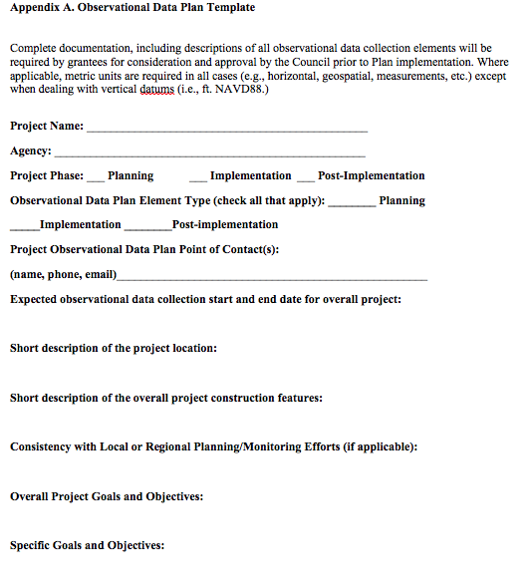
ODP Template: Appendix A

Slide 11
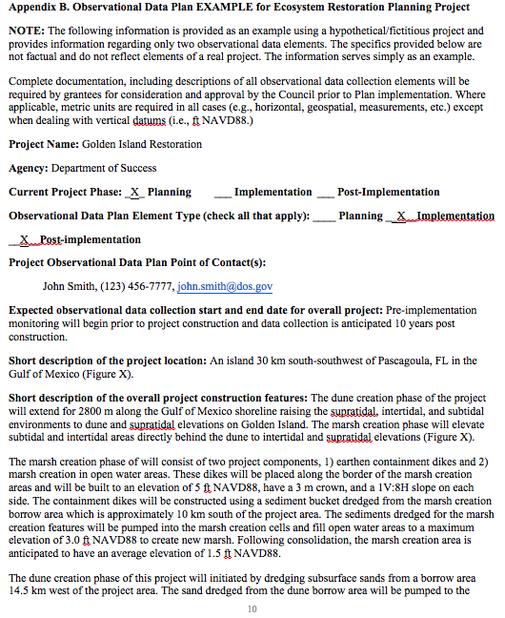
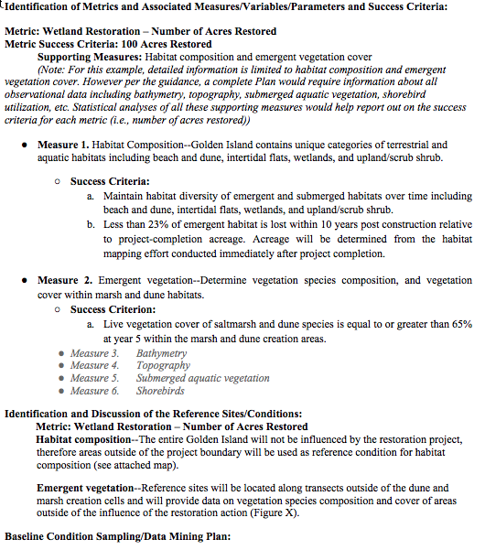
Example ODP: Appendices B-D
Notes:
Ex in Appendices B-D for various project types.
B for wetland restoration
C for a training/job corps
D for an infrastructure project
Appendix B: Current Project phase (Planning)
Will be an (Implementation) project
Umbrella Metric, specific measures, not all elaborated upon
Systematic progression through the template by measure for each category (success criteria, reference condition, baseline data, etc).

Slide 12
Interim Guidance: Example Metric
Sample “umbrella” metrics and supporting data:
Metric: Wetland Restoration – Number of Acres Restored (entered in RAAMS)
Metric Success Criteria: 100 Acres Restored
Measure I. Habitat Composition--Golden Island contains unique categories of terrestrial and aquatic habitats including beach and dune, intertidal flats, wetlands, and upland/scrub shrub.
Success Criteria: Maintain habitat diversity of emergent and submerged habitats over time including beach and dune, intertidal flats, wetlands, and upland/scrub shrub.
Notes:
Purpose: Document changes in habitat diversity and acreage of terrestrial and aquatic habitats over time and use these data with supporting datasets (bathymetry, topography, emergent vegetation cover, submerged aquatic vegetation, and shorebird utilization) to develop relationships between emergent habitat types and habitat utilization on Golden Island. This observational data will be used to measure project performance as a success criterion.

Slide 13
Interim Guidance: ODP
Sample “umbrella” metrics and supporting data:
Metric: Number people reached (entered in RAAMS)
Metric Success Criteria: At least 250 tribal youth and veteran participants annually
Measure I: Number of youth participants who gained or improved technical skills
Success Criteria: 50 students per year
Measure II: Number of veteran participants who gained or improved technical skills
Success Criteria: 100 veterans per year

Slide 14
Data Management Plan (DMP)
In addition to the Observational Data Plan, grantees must prepare and submit a Data Management Plan.

Slide 15
Interim Guidance: DMP
DMPs must be prepared, submitted, and approved prior to award of funds.
Recipients are responsible for providing all project-related data to the Council in digital, machine-readable, non-proprietary formats; described with appropriate metadata; and in compliance with all federal laws and policies. Please note: pdf is not a valid format for data.
The DMP Interim Guidance provides direction on data management and delivery/sharing

Slide 16
Interim Guidance: DMPs Include
DMPs must be prepared, submitted, and approved prior to award of funds.
Project name, sponsoring agency, project phase, and an estimated budget for data management
Contact information for one or more Data Stewards
Estimated data collection period (start and end dates)
A short description of the project location & data collection
A list of each of the data types (examples in Appendix D)
GIS information (if known and applicable)
Your organization’s data management and metadata capacities and how your organization intends to store, archive, and disseminate project data

Slide 17
Interim Guidance: DMPs
We acknowledge that data management capacities vary across organizations
Indicate if you need assistance
Digital data will be required to be provided to the Council for review and approval on a yearly basis (process under development)

Slide 18
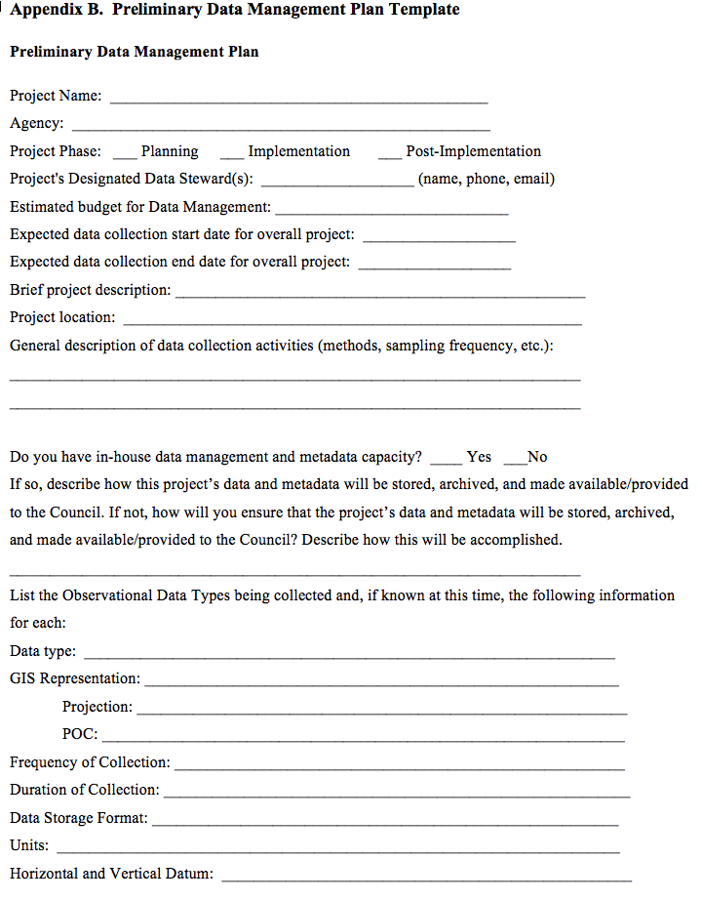
DMP Template

Slide 19
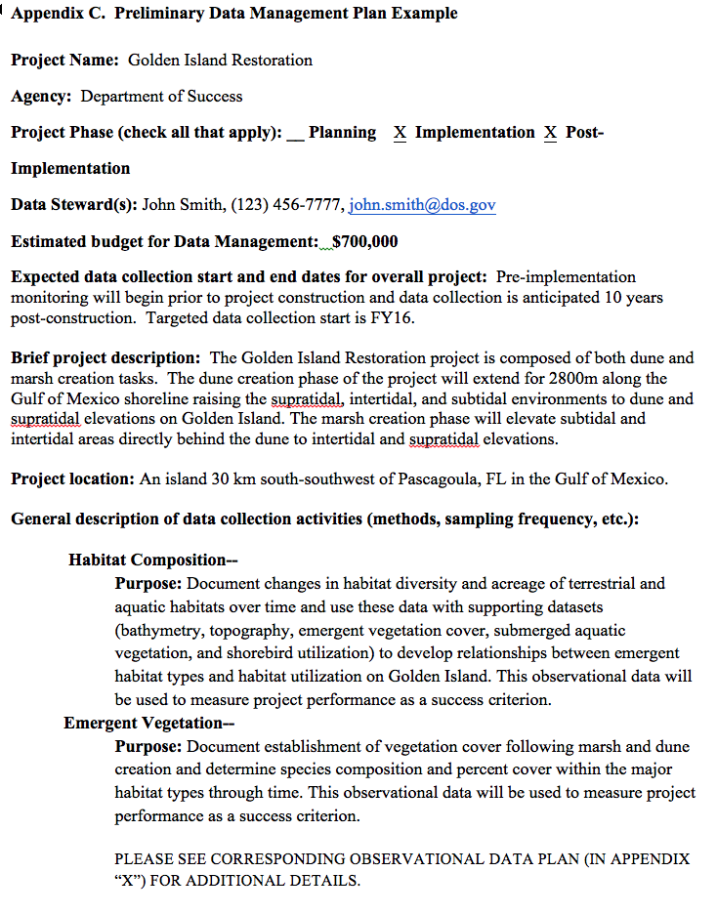
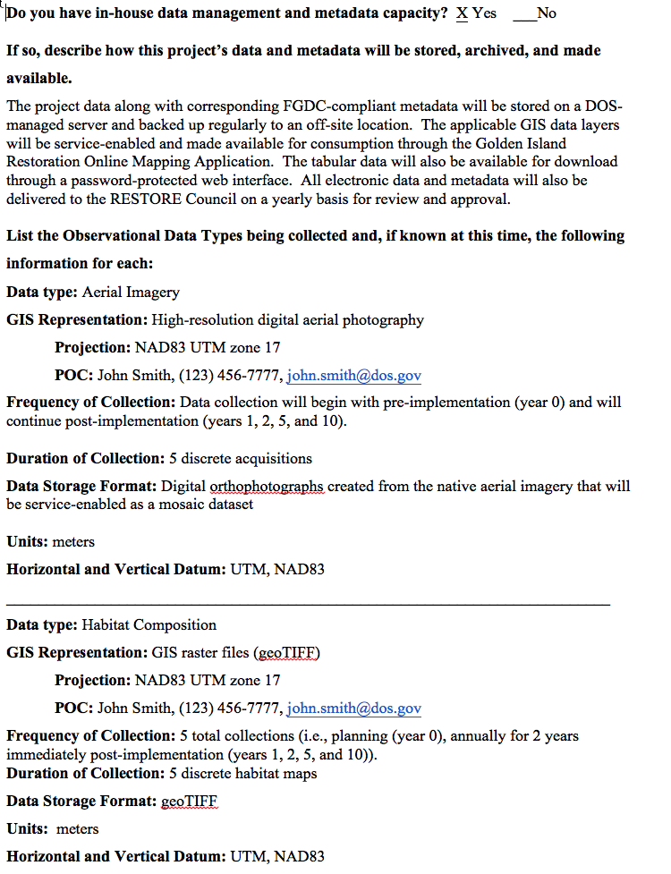
DMP Example

Slide 20
QUESTIONS?
Please email Jessica with additional general questions about this webinar & ODP/DMPs. We will compile questions & answers & send out to participants:
Jessica Henkel (Jessica.Henkel@restorethegulf.gov)
For questions about your specific project & program metrics:
Alyssa Dausman (Alyssa.Dausman@restorethegulf.gov)
For questions about RAAMS & RAAMS training:
Kristin Smith (Kristin.Smith@restorethegulf.gov)

